Slide 1
Stakeholder Survey Report
Red Oak School District

Slide 2
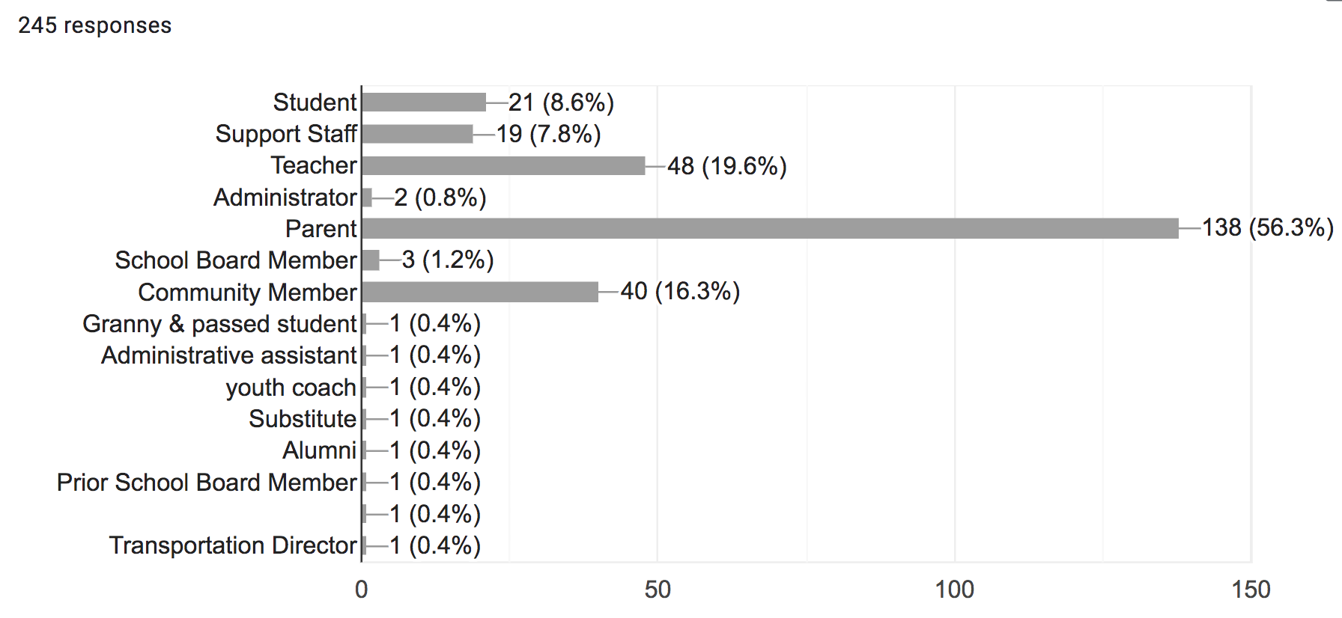
Overall participation (245 total)

Slide 3
strength areas or points of pride
District facilities
Career and Technical programs (Ag & Welding)
Sports and fine arts Programs
Dedicated staff
School pride

Slide 4
New facilities! Our small community typically bonds together to see that the students have resources available to them. I also appreciate that a majority, if not all, of our board members are Red Oak High School graduates and have a vested interest in the well-being of our students and facilities
Some areas of strength or points of pride for ROCS are student achievement for elementary, successful high school sports programs going to state, and 2 beautiful campuses.
Kids excel in the arts, especially the performing arts such as music and drama. We also have had great success in volleyball, girls basketball, and bowling this year. I feel that it's important to get those successes out to the community so that they hear about the good things these kids are doing
Opportunities for students to participate in a wide variety of extra curricular activities, caring staff that work hard to see student success, facilities that are awesome
Our new Jr-Sr High facility is a major point of pride. The fact that our community overwhelmingly supported the bond issue says a lot how much people support our school. We have teachers who care deeply about all students and are working tirelessly to help those students learn at high levels

Slide 5
challenges or areas for improvement
Retaining staff
Student discipline & Behavior
Facility Upgrade (Washington Building)
Higher academic test scores
Poverty/Apathy
Bullying

Slide 6
Academically, apathy is a struggle in the classroom. Parent/guardian support at home is a struggle as well. Too many of our kids are struggling to just make it day-to-day without adult support in the home.
I believe we can improve the way in which we connect with and teach our high population of low SES students. We are currently discussing ways in which our staff can focus our efforts to get this accomplished.
Poor student performance in behavior and attitude towards schooling, teacher turnover and restructuring in Math and English at the HS especially
Main thing is poverty. Second would be the fact that most households don't care enough about the well being of their children or their education, in order for them to have a future.
There is not a lot of help with behavior/challenging students at the elementary level. We have one teacher who is supposed to work with over 500 kids. There needs to be some kind of behavior class/ behavior teacher who focuses solely on the challenging behavior we face.

Slide 7
Top professional qualifications
Recruits, hires and develops a strong administrative team (59%)
Strong instructional Leader (49%)
Builds school and community relations (40%)
Promotes a community of care and support for students (37%)
Meaningfully engages with families and the community (34%)

Slide 8
Top personal traits
Is approachable, accessible and welcoming (75%)
Follows through on tasks and responsibilities (50%)
Brings out success in others (48%)
Demonstrates ethics and integrity (47%)
Possess strong communication skills (46%)

Slide 9
A person of power should always be approachable, follow through with what they're supposed to do, understand they don't know everything/there is always room for improvement, and makes clear decisions.
The district is making great improvements and we need a leader that will continue to push us to make it even better. We also need a leader who has good people skills- both to manage our staff and to build relationships of support with the community and families. We need a leader who knows our district, where we've come from, and where we are hoping to get to.
It is important to have someone who is going to help the teachers grow their own knowledge and be supportive of them. Something else that is very important is that they can treat everyone equally, parents and staff included.
It is important to have someone that is not from Red Oak or the surrounding area, so that they can bring fresh ideas to our school district. I would LOVE to see a fresh face and not someone from our school district.
I believe the superintendent of a school should be a strong leader that is highly engaged in the schools, and is a strong advocate for schools needs. They also need to be able to have level head in all situations.

Slide 10
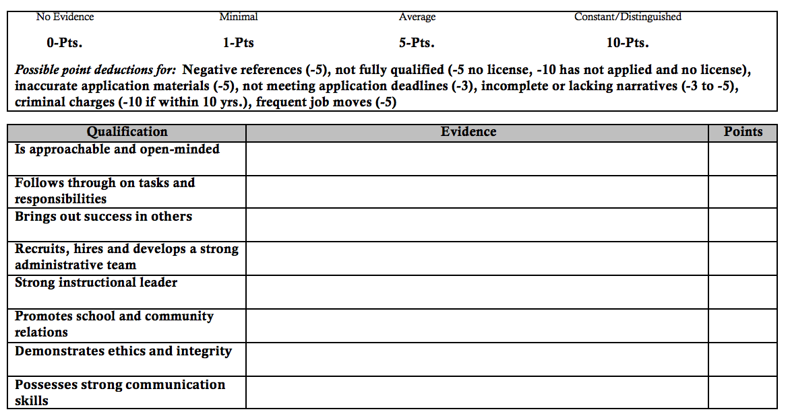
Candidate rating rubric

Slide 11
Survey advice

Slide 12
Next Steps
Feb. 28-March 23 Application period
April 1 Board reviews candidate pool
April 8 Board screens candidates
April 22 Formal interviews with finalists

Slide 13
